Slide 1
Hubot
Yun Ma, Young Liu
Xuzhou Yin, Xiao Liang

Slide 2
Overview
Project Updates
Risks
Our Schedule

Slide 3
What we had done
Get familiar with code structure
Add new features to query burn down rate(Although the data is randomly generated)
Update the code to use ES6 syntax
Set up automated unit test
Hook up Travis CI with Github
Set up pull review on Github
Hack the source code of Microsoft Bot Framework to make test output ideal

Slide 4
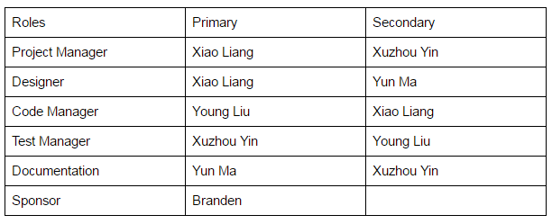
What we had done (cont.)
8. Roles

Slide 5
What we will achieve
Get more familiar with Jira
Use Jira as our team’s Agile tool
Specific duties for each team member:
Add workflow for the robot
Hook up API with Jira, interact with it using JavaScript code
Test the workflow with JavaScript code
Test the desired task/card creation with JavaScript code
Start experimenting with LUIS

Slide 6
Risk
Software not in total control. (Although can use Emulator)
Bot framework not compatible with Skype for Business
Not able to use Skype for Business since it’s not free
Not able to connect with NetJet’s Jira since it’s deployed internally

Slide 7
Our Schedule
Weekly meeting with sponsor(this Tuesday)
Talk about stuffs we just mentioned
Team meeting(last sunday)
Installed software like node.js and bot framework
Learned the sample code and try to create a rule
Unit testing & Travis-CI intergration
Documentation
Update roles
Update schedule

Slide 8
Thanks!

